Slide 1
Professional Practices
Risk Management
Some risks that are thought to be unknown, are not unknown. With some foresight and critical thought, some risks that at first glance may seem unforeseen, can in fact be foreseen. Armed with the right set of tools, procedures, knowledge and insight, light can be shed on variables that lead to risk, allowing us to manage them. (Daniel Wagner)

Slide 2
Week 13 Topic: Risk Management
Introduction:
What is Risk?
What is Risk Management?
What is Enterprise Risk Management?
Why Risk Management is so important?
What is Risk Management Process
Identify the Risk
Analyze the Risk
Qualitative Risk Analysis
Quantitative Risk Analysis
Evaluate the Risk
Treat the Risk
Monitor and Control Risk
Benefits of Risk Management

Slide 3
Introduction
What is Risk?
Risk is an uncertain event that may have a positive or negative impact on the project.
However, negative impact always gets more attention because of the consequences related to it.
What is Risk Management?
Risk management is an important business practice that helps businesses identify, evaluate, track, and mitigate the risks present in the business environment.
Risk management is practiced by the business of all sizes; small businesses do it informally, while enterprises codify it.

Slide 4
Introduction
What is Enterprise Risk Management?
Enterprise risk management (ERM) is a domain of governance that deals with the operational, environmental, financial, regulatory, market, and other risks that affect the outlook and planning of large enterprises.
Businesses prefer to use ERM software solutions to streamline risk management like LogicManager, Protecht.ERM, Enterprise Risk Management App etc.

Slide 5
Introduction
Why does Risk Management has such importance?
Risks can affect a project from many aspects, for instance:
the budget of a project,
planned schedule to meet its deadline,
scope and agreed level of quality of final product.
Risk management is important because it tells businesses about the threats in their operating environment and allows them to preemptively mitigate risks.
In the absence of risk management, businesses would face heavy losses because they would be blindsided by risks.

Slide 6
Introduction
Why does Risk Management has such importance?
As there are two kinds of risks, that is, positive events and negative events.
Normally businesses are required to focus on both ways while performing Risk management i.e.
Increase probability of occurrence of positive events.
Decrease probability of occurrence of negative events.

Slide 7
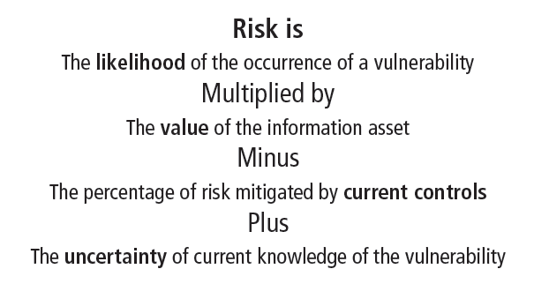
Introduction

Slide 8
Risk Management Process
Identify
Analyze
Evaluate
Treat
Monitor
Identify the Risk
Analyze the Risk
Evaluate and Rank the Risk
Treat the Risk
Monitor and Review the Risk

Slide 9
Risk Identification
Assets
Threats
Threat-sources: man-made, natural
Vulnerabilities
Weakness
Controls
Safeguard

Slide 10
Risk Management Process
1) Identify the Risk:
An important question while performing the Risk Management is, “what risk(s) has more probability of affecting the project”?
Various methods are used for the sake of identifying the risks.
Identify
Analyze
Evaluate
Treat
Monitor
Notes:
Information gathering is the most common method of identifying risk sources. It involves brainstorming sessions to obtain a comprehensive list of possible risks. It relies on the knowledge of experienced project participants, stakeholders and experts to identify the risk
Checklist analysis (CLA) is a technique that can be used to identify and manage risk. The checklist is developed by listing items, steps, or tasks and is then analyzed against criteria to determine if the procedure is completed correctly. The checklists should be developed using historical information or knowledge gained from similar projects in the past.
As per PMBOK , Assumptions Analysis is defined as “A technique that explores the accuracy of assumptions and identifies risks to the project from inaccuracy, inconsistency, or incompleteness of assumptions.” Assumption analysis is done during Risk identification process .
https://www.project-management-prepcast.com/pmbok-knowledge-areas-and-pmi-process-groups

Slide 11
Risk Management Process
1) Identify the Risk:
SWOT Analysis
A SWOT analysis is a compilation of your company's strengths, weaknesses, opportunities and threats.
The primary objective of a SWOT analysis is to help organizations develop a full awareness of all the factors involved in making a business decision.
Identify
Analyze
Evaluate
Treat
Monitor
Notes:
Information gathering is the most common method of identifying risk sources. It involves brainstorming sessions to obtain a comprehensive list of possible risks. It relies on the knowledge of experienced project participants, stakeholders and experts to identify the risk
Checklist analysis (CLA) is a technique that can be used to identify and manage risk. The checklist is developed by listing items, steps, or tasks and is then analyzed against criteria to determine if the procedure is completed correctly. The checklists should be developed using historical information or knowledge gained from similar projects in the past.
As per PMBOK , Assumptions Analysis is defined as “A technique that explores the accuracy of assumptions and identifies risks to the project from inaccuracy, inconsistency, or incompleteness of assumptions.” Assumption analysis is done during Risk identification process .

Slide 12
Risk Management Process
1) Identify the Risk:
Information gathering
It is the most common method of identifying risk sources.
It involves brainstorming sessions to obtain a comprehensive list of possible risks.
It relies on the knowledge of experienced project participants, stakeholders and experts to identify the risk
Identify
Analyze
Evaluate
Treat
Monitor

Slide 13
Risk Management Process
1) Identify the Risk:
Checklist Analysis (CLA)
CLA is a technique that can be used to identify and manage risks.
The checklist is developed by listing items, steps, or tasks and is then analyzed against criteria to determine if the procedure is completed correctly.
The checklists should be developed using historical information or knowledge gained from similar projects in the past.
Identify
Analyze
Evaluate
Treat
Monitor

Slide 14
Risk Management Process
1) Identify the Risk:
Assumptions Analysis
The Assumptions Analysis is defined as “A technique that explores the accuracy of assumptions and identifies risks to the project from inaccuracy, inconsistency, or incompleteness of assumptions.”
Identify
Analyze
Evaluate
Treat
Monitor

Slide 15
Risk Management Process
2) Analyze the Risk:
Qualitative Risk Analysis
Qualitative risk analysis is a technique used to quantify risk associated with a particular hazard. Risk assessment is used for uncertain events that could have many outcomes and for which there could be significant consequences.
Qualitative analysis can be performed using following methods:
Assess impact and likelihood of the identified risk.
Probability and Impact Matrix.
Risk categorization.
Risk urgency assessment.
Identify
Analyze
Evaluate
Treat
Monitor

Slide 16
Risk Management Process
2) Analyze the Risk:
Qualitative Risk Analysis
Assess impact and likelihood of the identified risk
The probability assessment involves estimating the likelihood of a risk occurring.
The impact assessment estimates the effects of a risk event on a project objective.
These impacts can be both positive and negative; i.e., opportunities and threats.
Identify
Analyze
Evaluate
Treat
Monitor

Slide 17
Risk Management Process
2) Analyze the Risk:
Qualitative Risk Analysis
Probability and Impact Matrix
It uses the combination of probability and impact scores of individual risks and ranks/ prioritizes them for easy handling of the risks.
In other words, the probability and impact matrix helps to determine which risks need detailed risk response plans.
Identify
Analyze
Evaluate
Treat
Monitor

Slide 18
Risk Management Process
2) Analyze the Risk:
Qualitative Risk Analysis
Risk categorization
Risk categorization, in project management, is the organization of risks based on their sources, areas of the affected project and other useful categories in order to determine the areas of the project that are the most exposed to the effects of risks or uncertainties.
Identify
Analyze
Evaluate
Treat
Monitor

Slide 19
Risk Management Process
2) Analyze the Risk:
Qualitative Risk Analysis
Risk urgency assessment
The risk urgency assessment is a project management process that reviews and determines the timing of actions that need to happen sooner than the other risk items.
The purpose of this particular type of risk assessment is that it identifies the near term risks.
Identify
Analyze
Evaluate
Treat
Monitor

Slide 20
Risk Management Process
2) Analyze the Risk:
Quantitative Risk Analysis
Quantitative risk analysis is a numeric estimate of the overall effect of risk on the project objectives such as cost and schedule objectives. The results provide insight into the likelihood of project success and is used to develop contingency reserves.
There are various ways used to analyze the risk in quantitative way:
Data gathering
Probability distribution
Modeling Techniques
Identify
Analyze
Evaluate
Treat
Monitor

Slide 21
Risk Management Process
2) Analyze the Risk:
Quantitative Risk Analysis
Data gathering
Direct: including surveys, questionnaires, direct observations, and focus groups.
Diagrammatic: Collecting the data from diagrams
Delphi: The Delphi method or Delphi technique is a structured communication technique or method, originally developed as a systematic, interactive forecasting method which relies on a panel of experts.
Identify
Analyze
Evaluate
Treat
Monitor

Slide 22
Risk Management Process
2) Analyze the Risk:
Quantitative Risk Analysis
Probability distribution
A statistical model based on probabilities of occurrence of some event.
Used to analyze the probability of occurrence of different risks quantitatively.
Identify
Analyze
Evaluate
Treat
Monitor

Slide 23
Risk Management Process
2) Analyze the Risk:
Quantitative Risk Analysis
Modeling Techniques
Decision tree Analysis
Sensitivity Analysis
Expert Judgment
Identify
Analyze
Evaluate
Treat
Monitor
Notes:
A Decision Tree Analysis is a graphic representation of various alternative solutions that are available to solve a problem. The manner of illustrating often proves to be decisive when making a choice.
Sensitivity analysis is the study of how the uncertainty in the output of a mathematical model or system can be divided and allocated to different sources of uncertainty in its inputs.
Expert Judgment is a term that refers a specifically to a technique in which judgment is made based upon a specific set of criteria and/or expertise that has been acquired in a specific knowledge area, or product area, a particular discipline, an industry, etc.

Slide 24
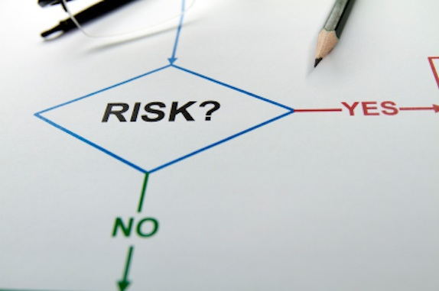
Risk Assesment
Assessing Potential Loss
Percentage of Risk Mitigated by Current Controls
Uncertainty
Risk Determination
Likelihood and Consequences

Slide 25
Risk Management Process
3) Evaluate and Rank the Risk:
Risks need to be ranked and prioritized.
Most risk management solutions have different categories of risks, depending on the severity of the risk.
A risk that may cause some inconvenience is rated lowly
Risks that can result in catastrophic loss are rated the highest.
Highest ranked risks require immediate attention of upper management
Low ranked can be dealt in the near future.
Identify
Analyze
Evaluate
Treat
Monitor

Slide 26
Risk Management Process
4) Treat the Risk:
Eliminate risks before they happen.
Decrease impact of risk(s).
Contingency plan: Do something if risk happens
Fallback plan: Do something if contingency plans are not effective
Identify
Analyze
Evaluate
Treat
Monitor
Notes:
A contingency plan is a plan devised for an outcome other than in the usual (expected) plan. It is often used for risk management for an exceptional risk that, though unlikely, would have catastrophic consequences. Contingency plans are often devised by governments or businesses.
The fallback plan is a part of the project management plan and defines under which circumstances action has to be taken. A fallback plan is implemented when the contingency plan fails or is not fully effective. It is a backup for the contingency plan.

Slide 27
Risk Management Process
4) Treat the Risk: Continued..
Negative risk or threat
Avoid
Transfer
Mitigate
Accept
Positive risk or opportunity
Exploit
Share
Enhance
Identify
Analyze
Evaluate
Treat
Monitor
Notes:
Risk mitigation is a strategy to prepare for and lessen the effects of threats faced by a business. Comparable to risk reduction, risk mitigation takes steps to reduce the negative effects of threats and disasters on business continuity. Threats that might put a business at risk include cyberattacks, weather events and other causes of physical or virtual damage. Risk mitigation is one element of risk management and its implementation will differ by organization.
Risk mitigation is the process of planning for disasters and having a way to lessen negative impacts.

Slide 28
Risk Management Process
5) Monitor and Review the Risk:
Risk Reassessment: Scheduled regularly to identify new risk
Risk Audit: Examine the effectiveness of planned risk response
Trend Analysis: Monitor overall project performance
Identify
Analyze
Evaluate
Treat
Monitor
Notes:
Risk reassessment in project management involves identifying new risks and reassessing current ones. It is also involved in closing risks that are outdated and no longer threatening to the project. This particular project management tool is used in controlling the risks.
Risk audit is the examination and documentation of the effectiveness of risk responses in dealing with identified risk and their root causes, as well as the effectiveness of the risk management process. Conducting a risk audit is an essential component of developing an event management plan.
Trend analysis is a technique used in technical analysis that attempts to predict the future stock price movements based on recently observed trend data. Trend analysis is based on the idea that what has happened in the past gives traders an idea of what will happen in the future.

Slide 29

Risk Control Strategies
Identify Possible Controls
For each threat and its associated vulnerabilities that have residual risk, create a preliminary list of control ideas. Three general categories of controls exist:
Policies
Programs
Technical controls

Slide 30
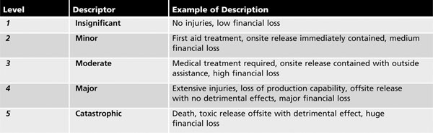
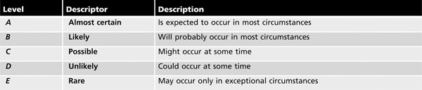
Examples
Likelihood and Consequences 1
Likelihood and Consequences 2

Slide 31
Risk Management Plan
Schedule Risk
Cost Risk
Quality Risk
Scope Risk
Resource Risk
Customer Satisfaction Risk

Slide 32
Benefits of Risk Management
Effective use of resources
Promoting continuous improvement
Fewer shocks and failures
Strategic business planning
Raised awareness of significant risks.
Quick grasp of new opportunities
Enhancing communication
Reassuring stakeholders
Focus on internal audit programme
Recognition of responsibility and accountability.

Slide 33
Assignment
Risk Assessment of
E-commerce sites
Stand along Systems
Distributed Systems
Remote Defense systems

